Slide 1

Team OTAVA
Digital Fabrication Project Group 32

Slide 2

Team Members
Ojjas Tyagi, CS20BTECH11060
Tanmay Garg, CS20BTECH11063
Anirudh Srinivasan, CS20BTECH11059
Vikhyath Sai Kothamasu, CS20BTECH11056
Aman Panwar, CS20BTECH11004

Slide 3
Project Simulation

Slide 4
Introduction
Our Project is an Orrery i.e., a working, interactive solar system model of all the planets up to Saturn
The time periods of the planets are as similar as possible to their real-life counterparts.
The intricate gear mechanism dictates how fast each planet should move
Along with mechanical parts, there are very interesting designs on every part of the project as well as detailing for planets

Slide 5
Origin
Some of us were interested in Solar System and Astronomy, so we searched on the internet for models of Solar System
The physical mechanical model of Solar System is called Orrery
We watched a video and were really inspired by it and so we modelled a Solar System similar to that in the video

Slide 6
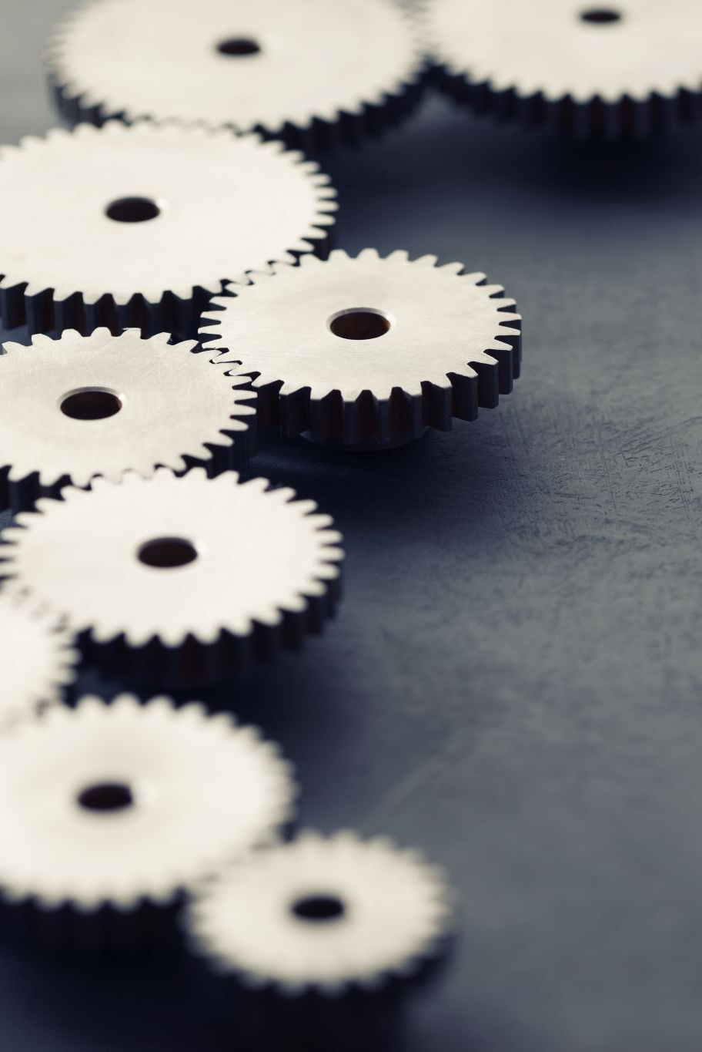
About the Project
The model consists of a total of 46 parts which are as follows:
20 gears: responsible for timing and movement
4 idler arms: arms for idler gears which connect the gear-train
6 planet arms: support and rotate planets
6 planets: detailed models of celestial bodies
Calendar disk: Shows the months, acts as idler as well
6 Pegs,1 Main axle,1 idler axle and 1 Sun.

Slide 7
Novelty, Challenge and Application
Novelty | Challenge | Application
Detailed modeling of Planets including textures. | Using Gear theory, Rigid body dynamics and Planetary time periods, all the gear ratios and radii of gears and dimensions of idlers and arms were calculated. | For teaching students about the solar system and to help them visualize the motion of the planets.
Innovative designs of gears. | High Printing time (~ 19 Hr.) | To understand motion and working of gears.

Slide 8
Contributions
Gear Design – Tanmay and Aman
Planet Modeling – Anirudh
Arms and Idlers – Vikhyath and Ojjas
Assembly File and Print – Tanmay

Slide 9
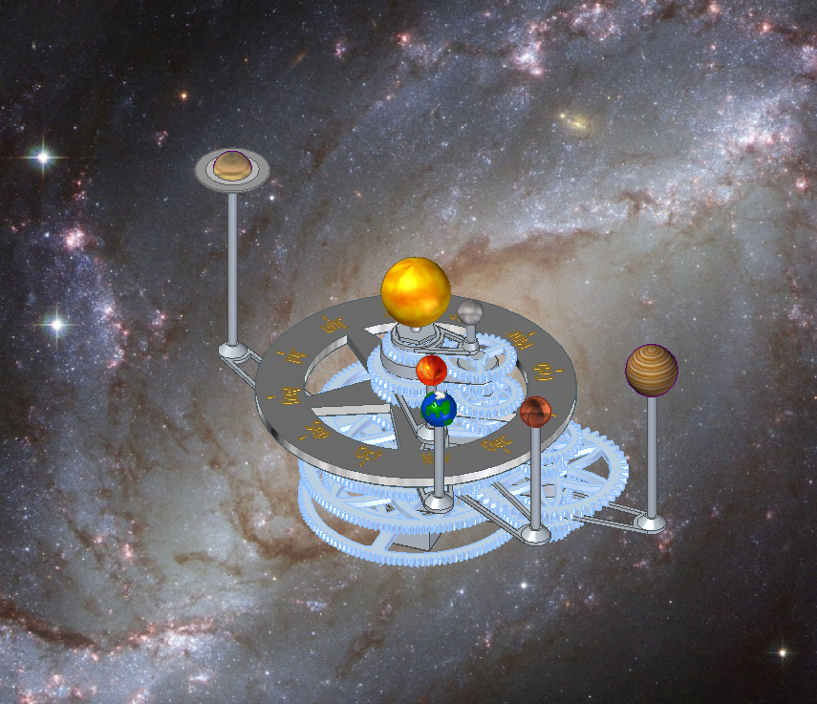
Project Assembly

Slide 10
Print Data
Printer: Fortus 450mc
Print time: 19 Hrs. 15 Mins.
Model Material: 468.033 cc
Support Material: 125.427 cc

Slide 11

Other Settings
Model Material: ABS-M30
Support Material: SR-30 Support
Slice Height: 0.2540 mm (T16)
Infill Style: Sparse
Support Style: Smart
Scale: 50% of original files
P.S: For more details, check print_estimation_grp32 in STL and Print – Grp 32.zip

Slide 12
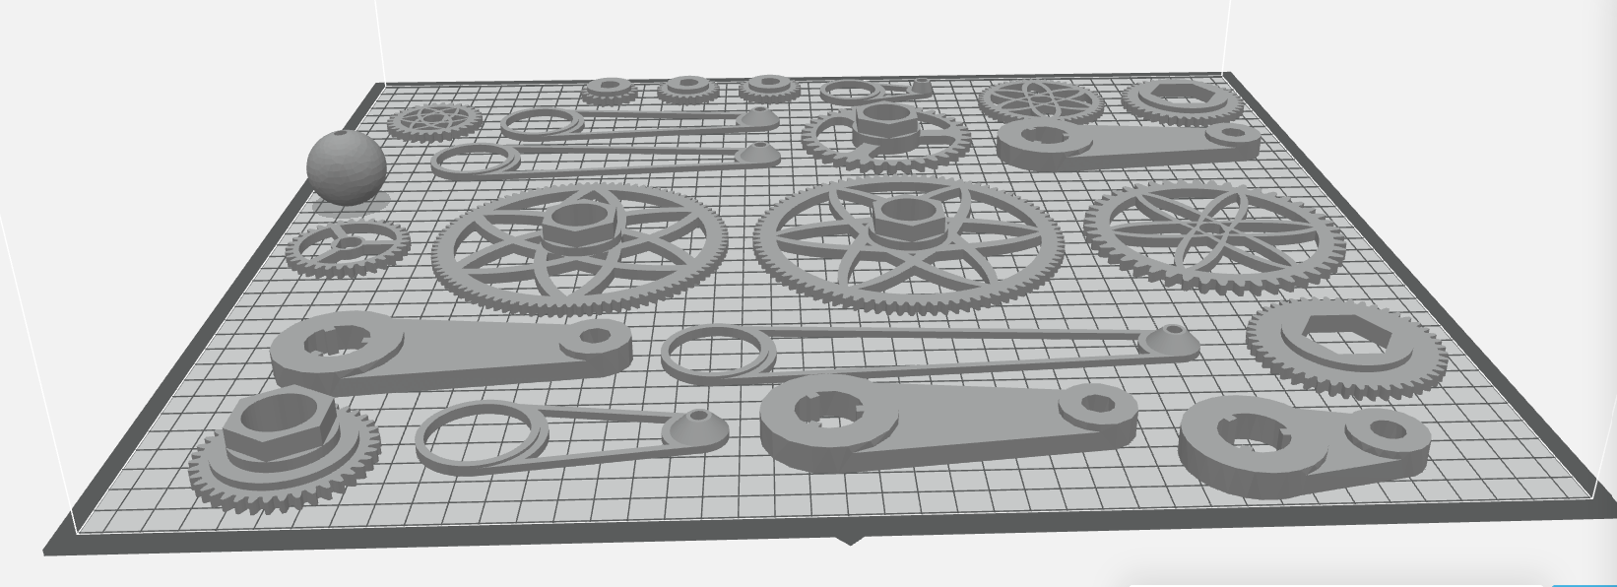
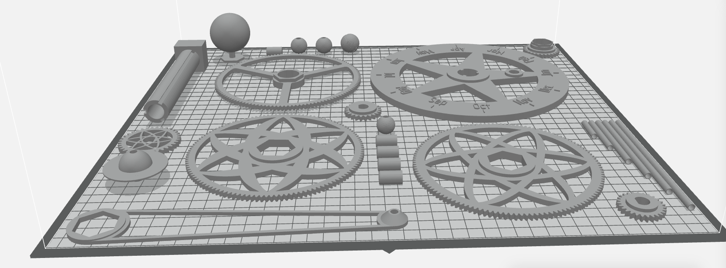
Orientation and Trays

Slide 13
Thank You

